Slide 1


Slide 2
Investigate TempDB Like Sherlock Holmes
Richard Douglas Senior Solutions Engineer at SentryOne rdouglas@SentryOne.com
@SQLRich

Slide 3

Ta sesja jest w języku angielskim
Teraz twój czas, aby wyjsc
z sesji ☺

Slide 4
Poważnie musiałem użyć Google Translate

Slide 5
Zanim wrócimy do Anglii, czuję, że muszę
przeprosić za 52% mojego kraju.

Slide 6


Slide 7
‘What object is served by this circle of misery and violence and fear? It must tend to some end, or else our universe is ruled by chance, which is unthinkable.’
Sherlock Holmes
-The Cardboard Box
That’ll be TempDB

Slide 8


Your host
Richard Douglas
Senior Solutions Engineer at SentryOne
Blogs:
http://blogs.sqlsentry.com/author/RichardDouglas
http://SQL.RichardDouglas.co.uk
Twitter: @SQLRich
Email: RDouglas@SentryOne.com
Slides: http://www.Slideshare.net/SQLRich

Slide 9

Agenda
Introduction to TempDB
The life of a temporary object
TempDB Architecture
How queries affect TempDB
Monitoring TempDB
Weird quotes
Cat pictures
Purlock Holmes?

Slide 10
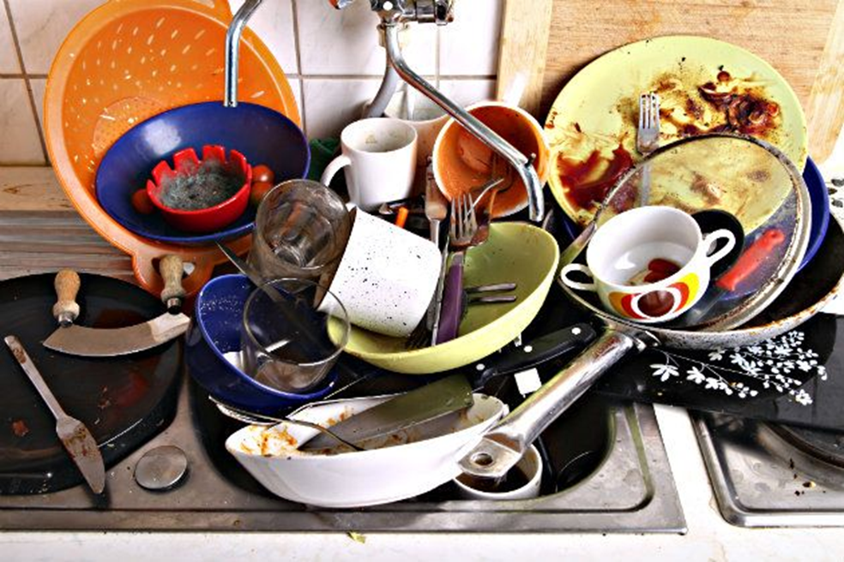
What is tempdb used for
Internal Objects
Joins and aggregations
Cursors
INSTEAD OF Triggers
Version Store
DML Triggers
Online Index Rebuilds
Snapshot Isolation
Query Operators
Sorts
Hashes
Spools
Temp Tables AND Table Variables
Notes:
When shredding XML and querying LOBs, these can be stored in TempDB.
INSTEAD OF Triggers uses Version Store

Slide 11
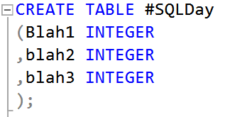
Temp table creation process
Remember: Things changed in SQL Server 2016. We’ll cover that too!
An SGAM page is read to find a mixed extent with space. An exclusive latch is placed
A PFS page is read to find a free page in the chosen extent. Again an exclusive latch is placed.
SGAM: Shared Global Allocation Map
PFS: Page Free Space Latch: Controls thread access to in-memory data structures
Why is this a problem?

Slide 12
‘It is a capital mistake to theorize before one has data. Insensibly one begins to twist facts to suit theories, instead of theories to suit facts.’
Sherlock Holmes
-A Scandal in Bohemia

Slide 13
You have a GAMmy database
Each User Database can have 1 or more Filegroups
Each User Database can have 1 or more Data files in said Filegroups
By default TempDB has 1 Filegroup with 1 data file. You cannot create a secondary Filegroup
TempDB will pick up certain defaults from the Model database
TempDB is reinitialised upon service restart

Slide 14
You have a GAMmy database (2)
Each Data File has “special” pages
PFS – Page Free Space, 1 per ca64MB
GAM – Global Allocation Map, 1 per ca4GB
SGAM – Shared Global Allocation Map, 1 per ca4GB
By default, TempDB has 1 data file sized at 8MB This means initially 1 SGAM page and 1 PFS page. We now have a resource bottleneck.
Page 1: First PFS
Page 2: First GAM
Page 3: First SGAM
Notes:
From Paul Randall
PFS stands for Page Free Space, but the PFS page tracks much more than that. As well as GAM intervals, every database file is also split (conceptually) into PFS intervals. A PFS interval is 8088 pages, or about 64MB. A PFS page doesn’t have a bitmap – it has a byte-map, with one byte for each page in the PFS interval (not including itself).
The bits in each byte are encoded to mean the following:
bits 0-2: how much free space is on the page
0x00 is empty
0x01 is 1 to 50% full
0x02 is 51 to 80% full
0x03 is 81 to 95% full
0x04 is 96 to 100% full
bit 3 (0x08): is there one or more ghost records on the page?
bit 4 (0x10): is the page an IAM page?
bit 5 (0x20): is the page a mixed-page?
bit 6 (0x40): is the page allocated?
For instance, an IAM page will have a PFS byte value of 0x70 (allocated + IAM page + mixed page). You can examine PFS pages using DBCC PAGE (the instructions in that post use a PFS page as an example).
Free space is only tracked for pages storing LOB values (i.e. text/image in SQL Server 2000, plus varchar(max)/varbinary(max)/XML and row-overflow data in SQL Server 2005) and heap data pages. This is because these are the only pages that store unordered data and so insertions can occur anywhere there’s space. For indexes, there’s an explicit ordering so there’s no choice in the insertion point.
The point at which a PFS byte is reset is not intuitive. Just yesterday I was helping a couple of MVPs with an issue and one of the questions was (paraphrasing) “This page has a PFS byte value of 0x04 – how can it be full when its not allocated?”
The answer is that PFS bytes are not fully reset until the page is reallocated. On deallocation, the only bit in the PFS byte that’s changed is the allocation status bit – this makes it very easy to rollback a deallocation.
-----------------------------------------------------
GAM
GAM stands for Global Allocation Map. If you remember from before, database data files are split up into GAM intervals (don’t get confused – they’re not split physically, just conceptually). A GAM interval is equivalent to the amount of space that the bitmaps in GAM, SGAM, and IAM pages track – 64000 extents or almost 4GB. These
bitmaps are the same size in each of these three page types and have one bit per extent, but they mean different things in each of the different allocation pages.
One thing to note, at the start of every GAM interval is a GAM extent which contains the global allocation pages that track that GAM interval. This GAM extent cannot be used for any regular page allocations.
The bits in the GAM bitmap have the following semantics:
bit = 1: the extent is available for allocation (you could think of it as currently allocated to the GAM page)
bit = 0: the extent is already allocated for use These semantics are the same for mixed and dedicated/uniform extents.
----------------------------------------------------
the SGAM bitmap is exactly the same as the GAM bitmap in structure and the interval it covers, but the semantics of the
bits are different:
bit = 1: the extent is a mixed extent and has at least one unallocated page available for use
bit = 0: the extent is either dedicated or is a mixed extent with no unallocated pages (essentially the same situation given that the SGAM is used to find mixed extents with unallocated pages)

Slide 15
How many tempdb files?
Well it depends…
Best current wisdom can be found in KB215845
As a general rule, if the number of logical processors is less than or equal to 8, use the same number of data files as logical processors. If the number of logical processors is greater than 8, use 8 data files and then if contention continues, increase the number of data files by multiples of 4 (up to the number of logical processors) until the contention is reduced to acceptable levels or make changes to the workload/code.

Slide 16
Adding TempDB files

Slide 17
Adding TempDB files

Slide 18
2016 Temp table creation process
SQL Server 2016 enables trace flags 1117 and 1118 by default.
1117 – Grow all files in a file group equally
1118 – Use Full extents only

Slide 19
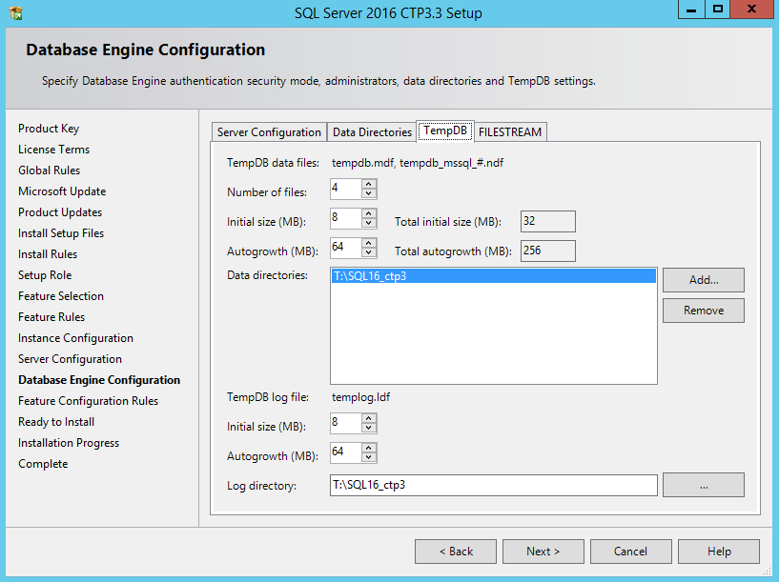
Other new features
Command line option for multiple TempDB files can be set via parameter /SQLTEMPDBFILECOUNT

Slide 20
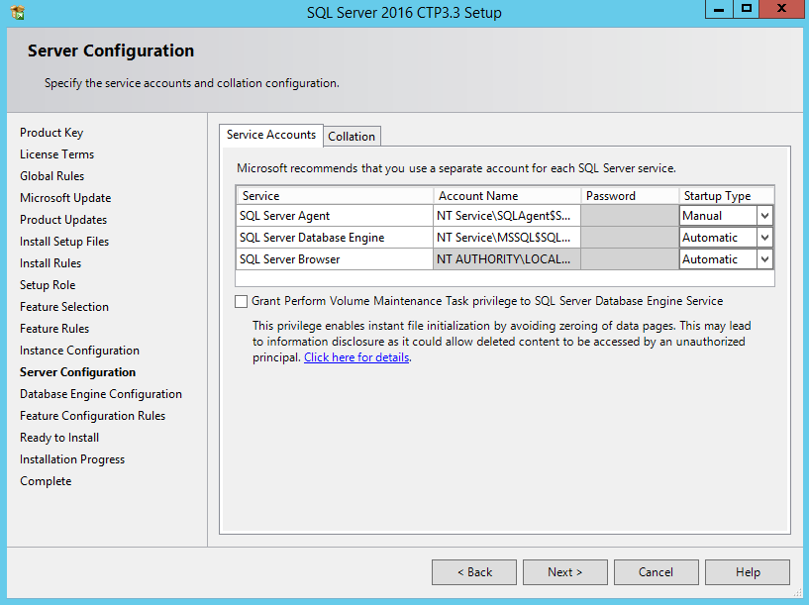

Slide 21
Performance tuning adage
‘It has long been an axiom of mine that the little things are infinitely the most important.’
Sherlock Holmes
-A Case of Identity

Slide 22


Slide 23
Temp table caching
The following stops the ability to cache temp tables:
Creating a named constraint
Using DDL after creation
Creating using dynamic SQL
Used in an ad-hoc command

Slide 24
Memory grants
Query submitted
Optimizer checks stats
Predicts memory needed
Tries to assign contiguous memory (Memory Grants Pending)
Query runs
(Hopefully)

Slide 25
Memory grants in action

Slide 26
worktables
Work tables are internal structures used for a number of purposes:
Service Broker
DBCC CheckDB
Cursors
Group By, Union, and some Order By statements
Spools
*Work tables are allocated to mixed extents
Work tables can be cached to improve performance
Work tables have a negative objectid

Slide 27
workfiles
Similar to work tables
Are used for hashing operations
They store temporary result sets for hash joins and hash aggregates

Slide 28
“The world is full of obvious things which nobody by any chance ever observes.”
Sherlock Holmes
-The Hound of the Baskervilles
Chapter 3: “The Problem”

Slide 29
Measuring tempdb performance

Slide 30
Perfmon Counters
Access Methods – Workfiles Created/Sec
Access Methods – Worktables Created/Sec
Access Methods – Worktables From Cache Base
Access Methods – Worktables From Cache Ratio

Slide 31
Perfmon Counters
Cursor Manager By Type – Cursor Worktable Usage
TSQL Local Cursor
TSQL Global Cursor
API Cursor
Cursor Manager Total – Cursor Conversion Rate

Slide 32
Perfmon Counters
General Statistics – Active Temp Tables
General Statistics – Temp Tables Creation Rate
General Statistics – Temp Tables For Destruction
Logical Disk - Avg Disk Bytes/Read
Logical Disk - Avg Disk Bytes/Write
Logical Disk - Avg Disk sec/Read
Logical Disk - Avg Disk sec/Write

Slide 33
Perfmon Counters
Transactions - Free Space in TempDB(KB)
Transactions - Transactions
Transactions - Snapshot Transactions
Transactions - Version Cleanup Rate (KB/s)
Transactions - Version Generation Rate(KB/s)
Transactions - Version Store Size(KB)
Notes:
Transactions - Free Space in TempDB(KB):
Transactions – Snapshot Transactions: The total number of active snapshot transactions.

Slide 34
Space usage
SELECT
SUM (user_object_reserved_page_count)*8 as Usr_Obj_kb,
SUM (internal_object_reserved_page_count)*8 as Internal_Obj_kb,
SUM (version_store_reserved_page_count)*8 as Version_Store_kb,
SUM (unallocated_extent_page_count)*8 as Freespace_kb,
SUM (mixed_extent_page_count)*8 as MixedExtent_kb
FROM sys.dm_db_file_space_usage
High % suggests majority of space is taken up by applications creating temporary objects

Slide 35
Space usage
SELECT
SUM (user_object_reserved_page_count)*8 as Usr_Obj_kb,
SUM (internal_object_reserved_page_count)*8 as Internal_Obj_kb,
SUM (version_store_reserved_page_count)*8 as Version_Store_kb,
SUM (unallocated_extent_page_count)*8 as Freespace_kb,
SUM (mixed_extent_page_count)*8 as MixedExtent_kb
FROM sys.dm_db_file_space_usage
High % suggests majority of space is taken up by query plan operators. Optimising queries will reduce space usage.

Slide 36
Space usage
SELECT
SUM (user_object_reserved_page_count)*8 as Usr_Obj_kb,
SUM (internal_object_reserved_page_count)*8 as Internal_Obj_kb,
SUM (version_store_reserved_page_count)*8 as Version_Store_kb,
SUM (unallocated_extent_page_count)*8 as Freespace_kb,
SUM (mixed_extent_page_count)*8 as MixedExtent_kb
FROM sys.dm_db_file_space_usage
High % suggests majority of space is taken up by version store. Look to curtail long running queries.

Slide 37
Sherlock says to baseline
‘You see, but you do not observe. The distinction is clear.’
Sherlock Holmes
-A Scandal in Bohemia

Slide 38
Learn more about baselining
My Baselining session:
The Day After Tomorrow; Why You Need to Baseline
SQLBits Recording:
http://www.sqlbits.com/Sessions/Event12/The_Day_After_Tomorrow_Why_You_Need_to_Baseline
SlideShare:
http://www.slideshare.net/SQLRich/the-day-after-tomorrow-why-you-need-to-baseline-sql-rally-2013-amsterdam

Slide 39
Sherlock on consultants
‘I listen to their story, they listen to my comments, and then I pocket my fee.’
Sherlock Holmes
-A Study in Scarlet
Chapter 2: “The Science of Deduction”

Slide 40

‘Having gathered these facts, Watson, I smoked several pipes over them, trying to separate those which were crucial from others which were merely incidental.’
Sherlock Holmes
-The Crooked Man

Slide 41
THANK YOU!
Slides will be available at http://Slideshare.net/SQLRich
My contact info for other questions:
RDouglas@Sentryone.com
Twitter: @SQLRich
Blogs: http://SQL.RichardDouglas.co.uk / http://http://blogs.SentryOne.com/author/RichardDouglas

